Slide 1
Setting Homework in SIMS

Slide 2
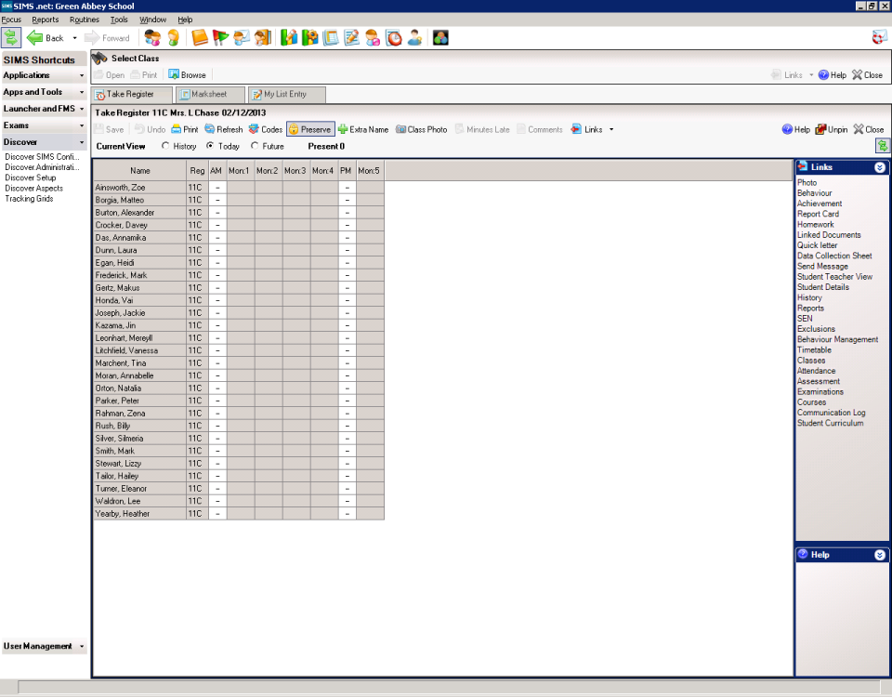
From the register:
Select all students

Slide 3
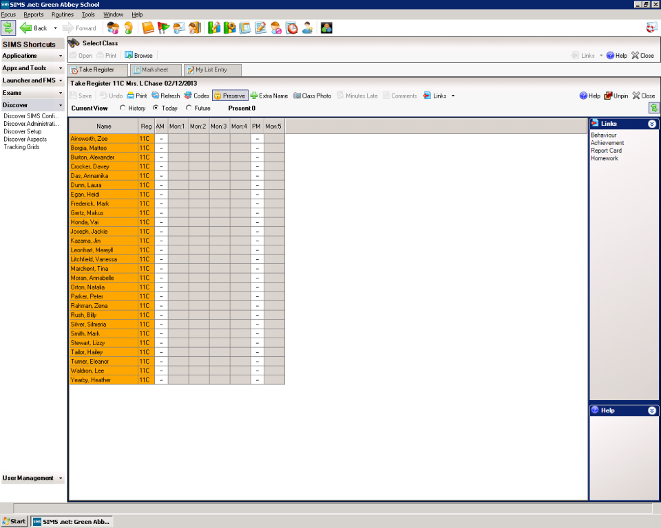
Click Homework on right of screen

Slide 4
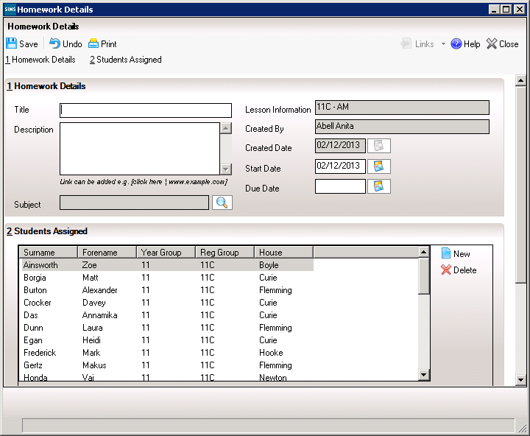
Fill in details for Title, Description and due date

Slide 5
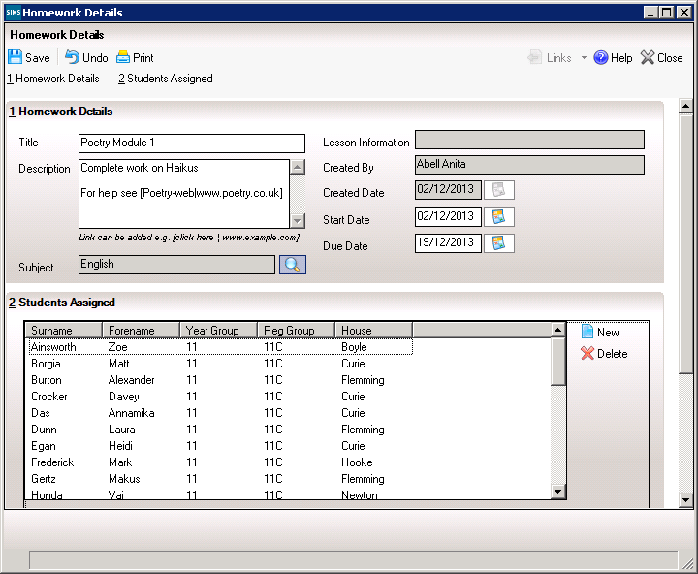
Weblinks can be typed in this format:
[Click Here | www.website.co.uk]

