Slide 1
Exams Autumn Release
Paul Walton
Autumn 2021

Slide 2
England and Wales Regions
XML Results File Importing

Slide 3
XML Results File G
Main business driver is DfE and Ofqual (via JCQ) wanting to provide schools with more data about exams, beyond overall result
Originally was just to be “additional” results – Scaled/Weighted Marks, Endorsements Etc. However….
… the final solution is an XML structure which can be used to import all results – Referred to as Results File G (XML Results file)
The XML file includes both existing EDI Results File R results and new additional results
Option to bring in all results this way was dismissed due to very high risk of moving all functionality for Exams results imports to a new methodology in one go for main summer results
Main risks being impacts on all Summer Exams Results Processing and related functionality for a very large number of secondary schools… Eeek!
Opted instead to bring in all other additional results and get functionality working on low risk results data and once this has been proven look at possibility of bring all results in this way in the future

Slide 4
XML Results File G
Will only be used by four boards initially;
AQA
WJEC
Pearson
OCR
CCEA is not implementing XML result
Will only be used by England and Wales
Though new category has been set up for NI as well for possible future use

Slide 5
XML Results File G
Uses the A2C XML Schema so will be compatible for both SIMS7 and NextGen (EDI and A2C results)
XML Results files will be sent via the Migration App as normal along with EDI R results files (Migration App to be updated to avoid error messages and use new protocols etc)
There is no requirement to import this XML results file. It is optional. Therefore…
… for now EDI Results File R should still be imported as the single source of overall exams results!

Slide 6
XML Results File G
XML files will be named a2c.CCCCC.AB.EDIResults.GUID.xml
where CCCCC is a 5 digit alpha-numeric centre number (for EDI results always a numeric NCN) and AB is the 2 digit AO identifier (same as the EDI AB identifier) and GUID is the same GUID used in the Message ID
The year and series are not included in the filename.
For example, a results file for centre 12345 from AO 41 with a MessageID of 35b85693-cb69-4d2b-9fc4-aa2e9e9acd5c would have a filename a2c.12345.41.EDIResults.35b85693-cb69-4d2b-9fc4-aa2e9e9acd5c.xml
The same GUID should be used as the MessageID in the MsgHeader.
Customers with multiple centre numbers will have a separate results file for each NCN.
AOs with multiple AO IDs must not combine different AO IDs in a single file. The schema supports only one AO ID per file. The filename for an R file and for xml results both contain the AB identifier so by definition can contain results for only one board.

Slide 7
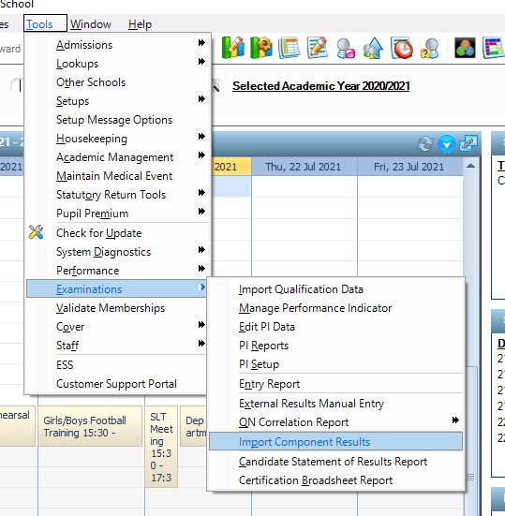
XML Results File G – Import Menu
Tools | Examinations | Import Component Results

Slide 8
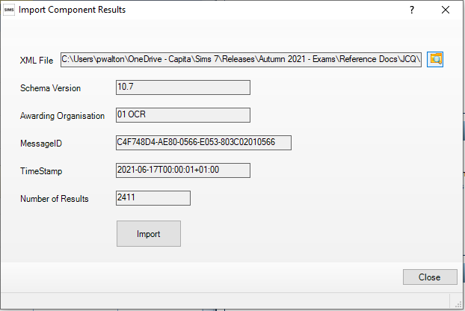
XML Results File G – Import Menu
Tools | Examinations | Import Component Results

Slide 9
XML Results File G – Initial Validation
When a file is selected, the following validations are applied before the “Import” button becomes active;
It is a recognised xml file?
Do I have the expected schema version available in the Pulsar folder?
Is the correct file for the school? This is undertaken by checking that the results ID is appropriate to the school's exam centre number?
Was initiated by a known Awarding Organisation (AO)? This is determined by checking the value of the Initiator_Party_Id node against the routing codes for the list of active Exam Boards in SIMS
Does the file contain at least one result?
Has this file been imported before?

Slide 10
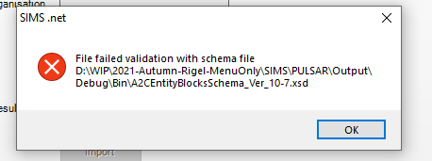
XML Results File G – Initial Validation
Error message when validation schema file is not present:
Currently we support versions 10.7, 10.8 and 10.9

Slide 11
XML Results File G – Initial Validation
Other validation messages:
Validation Failure Messages | Reason
File failed validation with schema file <full path to schema file> | The file selected does not conform to the required Xml Schema
File content not recognised as a Result file | The TransactionName node is not set as "ProcessResults"
Centre Number ##### not recognised for this school! | The Receiver_Party_Id content does not match the Default Centre Number set in Exams Organiser for this school.
Awarding Organisation ## not recognised! | The Initiator_Party_id content does not match any Active Exam Board Routing Code in Exams Organiser
Result file has failed verification. File rejected: missing or invalid datablocks | There are no recognisable QEOutcome_DS data blocks in the file. This would mean that a result file has been sent by an AO with no actual results in it.

Slide 12
XML Results File G – Initial Validation
Other validation messages:
The following should never be seen but are there just in case. | Why it should not happen
Schema Version not found! | The SchemaVersion node is missing from the file. The file supplied is not correct (AO problem) or is not a Xml Result file.
Cannot locate the Schema file at <full path to schema file> | All required Xml schema files are distributed with the release.
No ReceiverID found in XML file | The Receiver_Party_Id node is missing from the file. This should be trapped by the schema file check.
No Awarding Organisation found in XML file | The Initiator_Party_Id node is missing from the file. This should be trapped by the schema file check.
No TimeStamp found in XML file | The TimeStamp node is missing from the file. This should be trapped by the schema file check.
TimeStamp is blank! | The TimeStamp node content is blank. This should be trapped by the schema file check.
No MessageID found in XML file | The MessageID node is missing from the file. This should be trapped by the schema file check.
MessageId is blank! | The MessageID node content is blank. This should be trapped by the schema file check.
Result file has failed verification. Message structure does not conform to A2C schema | This should be trapped by the schema file check.

Slide 13
XML Results File G – Initial Validation
If a file has already been imported the user will get a warning message
Imported means that based on a record in the sims tables which is generated when a single result is stored, this is considered a successful import
Re import allows for files to be reimported in case of issues although this should not be necessary as all results file will be updated by new files where there are issues or remarks etc.

Slide 14
XML Results File G – Initial Validation
Important Note:
Where ever possible import results files in order
The system will handle results files out of order but there are circumstances where not doing so could cause issues to be aware of:
For example; Issued Result 1 – Pending Result 2 – Issued Result 3
Issued result 1 stored, pending result 2 will delete original result 1 and then issued result 3 will store updated result all with correct dates
However once pending result removes existing result the system does not know any result exists so any new result will be stored regardless of date

Slide 15
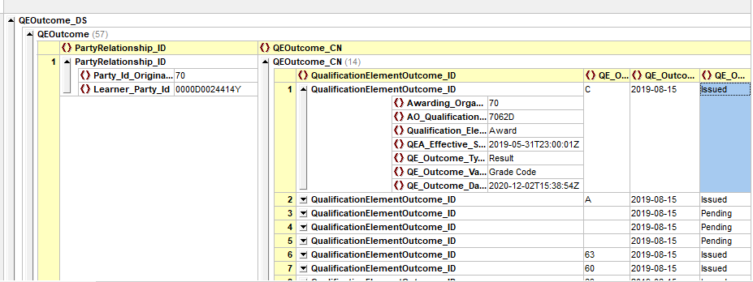
XML Results – Student Identification
The Student is identified by comparing the UCI Number in the results file (using the Party Relationship Role) with those in the SIMS database
No match found – No import of result

Slide 16
XML Results Import Log
If an XML Results File is reimported then the system will use the standard importing rules to determine if a result should be over written
If the result is newer than the same instance of that result in SIMS then it will be imported and the old value overwritten
If the result is the same date:time or older then it will be ignored
Therefore unless file is manually changed no results should be reimported… Hence updated files will be provided in cases of change being required
Note: If a result has been issued for a Scaled / Weighted Mark and then set back to pending we will delete the existing result and then add the new result if and when this is imported
Important Note: Message is subject to ordering of validation!!!

Slide 17
Types of Results Imported
Qualification Element Type | QE Outcome Value Type | QE Outcome Type | Aspect Created as Part of Import if Required | Category Used | Import (Result) | Aspect Type
Award | Grade Code | Result | No Created by Basedata Import |  | No EDI R | Grade
Award | Scaled/Weighted Mark | Result | Yes | SWM | Yes XML | Marks Decimal
Award | Uniform Mark Scale | Result | No Created by Basedata Import |  | No EDI R | Marks Decimal
Award | Grade Code | Endorsement Result | No Created by Basedata Import |  | No EDI R | Grade
Learning Unit | Grade Code | Result | No Created by Basedata Import |  | No EDI R | Grade
Learning Unit | Scaled/Weighted Mark | Result | Yes | SWM | Yes XML | Marks Decimal
Learning Unit | Uniform Mark Scale | Result | No Created by Basedata Import |  | No EDI R | Marks Decimal
Assessable | Grade Code | Result | Yes | Component Result | Yes XML | Grade
Assessable | Scaled/Weighted Mark | Result | Yes | SWM | Yes XML | Marks Decimal
Assessable* | Grade Code | Endorsement Result | Yes | Component Result | Yes XML | Grade
* This is coded for as some of the boards have not been consistent in naming the outcome type as Result in test files. However in reality this value should never be received as boards have agreed to called Endorsements at the Assessable level "Result" not "Endorsement Result".

Slide 18
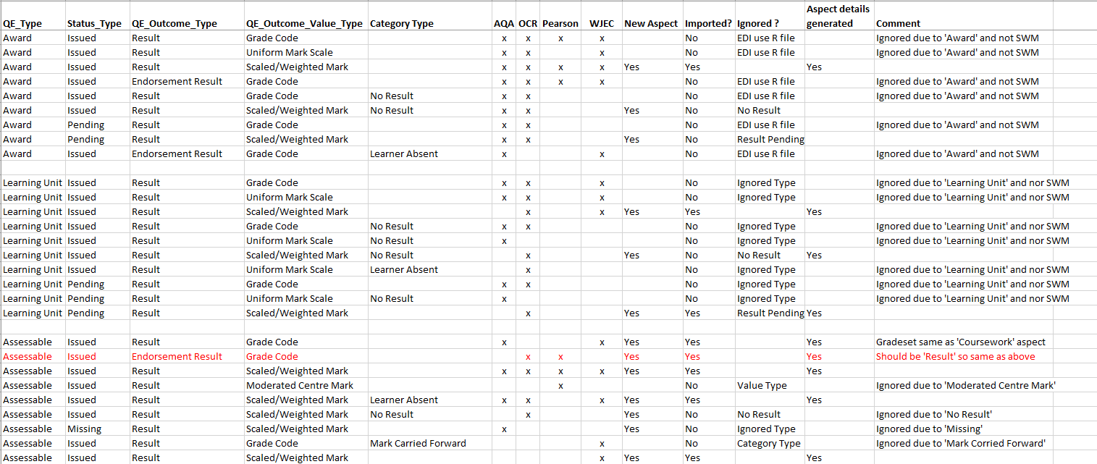
Types of Results Imported - Detailed

Slide 19
XML Results Import Log
Top section shows totals and does not change regardless of tick boxes checked
Tick boxes are off by default so report shows only issues arising or failures
Tick boxes affect report content only (if no results of that type box is disabled)
See next slides for more information about the affect of check boxes on report

Slide 20
XML Result Status Messages
Status text | Reason | Notes
Unknown Learner | The UCI does not match any of the Exam Candidates in the SIMS database | This should not happen in the real world but will certainly happen if the details of the candidates in the test files have not been imported into the SIMS database and the students set as exam candidates.
Unknown Element | The value at node AO_Qualification_Element_Id does not exist in the SIMS database. | This is due to the qualification basedata not being imported into EO. This should not happen in the real world since the school would have already imported the basedata before the students were entered for the exams.
Ignored Type | Ignore if result to be processed has a Status_Type that is not either ‘Issued’ or ‘Pending’
Ignored Category Type (Mark Carried Forward) | Ignore if result is a previously carried forward result. | We are not interested in carried forward results as they have previously been recorded.
Ignored Value Type | Ignore unless QE_Outcome_Value_Type is ‘Grade Code’ or ‘Scaled/Weighted Mark’ | We are not interested in other types of results in this release.
Ignored - No Result | Ignore 'No Result' values where the QE_Outcome_Value_Type is ‘Scaled/Weighted Mark’ | We are not interested in results where the QE_Outcome_Category_Type is ‘No Result’

Slide 21
XML Result Status Messages
Status text | Reason | Notes
Ignored - Result Pending | Ignore ‘Pending’ values where the QE_Outcome_Value_Type is ‘Scaled/Weighted Mark’
Ignored - EDI | Any result which can be imported via the EDI R file route is ignored in this release
Ignored - Blank result | The ‘Scale/Weighted Mark’ has no result value
Ignored - Later result recorded | There is already a result in SIMS which has a later result date/time. | This can happen if an earlier result is imported after a later one.
Ignored - Result already recorded | A result with the same value and result datetime is already in SIMS | This will happen if a result file is reimported as the results will have already been recorded in SIMS.
Ignored - Result recorded for this date/time | A result with a different value but the same result datetime is already in SIMS. | This should not happen in the real world but if it is encountered then the current value in SIMS will be displayed in the Previous Result column.
Success | The result has been imported and recorded in SIMS.

Slide 22
XML Result Status Messages - additional
Status text | Reason | Notes
Ignored – Result Not SWM | Ignore values which do not represent a positive numeric value where the QE_Outcome_Value_Type is ‘Scaled/Weighted Mark’ | Examples: 0, 123 and 123.45 are valid -123, A1, 1A and A are invalid

Slide 23
XML Result Status Messages - Unlikely
Status text | Reason | Notes
NoAspect | It has not been possible to find the required aspect in the SIMS database. | These scenarios should not happen but are there to identify the reason for a result not being imported in order that a technical investigation can take place if necessary.
NoGradeset | It has not been possible to find the required gradeset in the SIMS database.
NoSeries | It has not been possible to find the required exam Series in the SIMS database.
NoResultset | It has not been possible to find the required Resultset in the SIMS database.
BadGrade | It has not been possible to find the result Grade Code value in the gradeset in SIMS.
Ignored | This is a ‘catch all’ which should never happen.

Slide 24
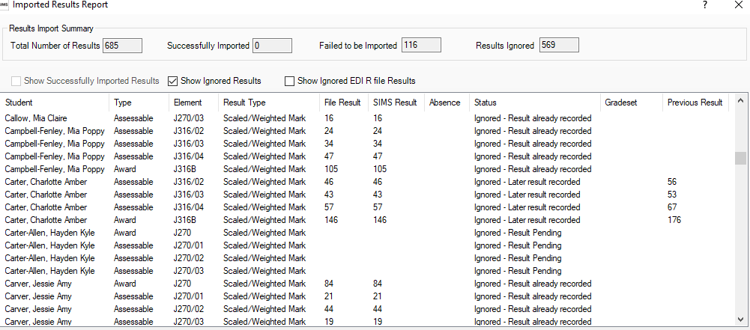
XML Result Status Messages - Examples

Slide 25
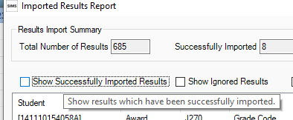
XML Check Box Hover Help Messages
Show Successfully Imported Results
Will include in the report all those results we have successfully managed to import
Hover help provides summary of this to the user

Slide 26
XML Check Box Hover Help Messages
Show Ignored Results
Will include in the report all those results that have been ignored for any reason other than they will have been included in the normal EDI R results file; See next slide for examples
Hover help provides summary of this to the user

Slide 27
XML Check Box Hover Help Messages
Show Ignored EDI R File Results
Will include in the report all those results that have been ignored as they will have been included in the normal EDI R results file; For example
Overall Award Grade
Overall Unit Grade Etc.
User will need to import the EDI R Results file through Exams Organiser as normal to get these results – we will look to develop this new import for all results in the future
Hover help provides summary of this to the user

Slide 28
England and Wales Regions
XML Results Assessment Resources

Slide 29
XML Results – Aspects (Scaled/Weighted Mark)
The naming of aspect details follows the same basic rules used by EO when basedata is imported; See example below for a SWM Award Aspect…
Aspect Name: AO + ‘ ‘ + Entry Code + ‘ Scaled/WtdMark A’
Aspect External ID: AO Routing Code + Entry Code + ‘Scaled/WtdMarkA’
Aspect Column Name: AO Routing Code + ‘ ‘ + Entry Code + ‘ SWM’
Aspect Description: 'Scaled/Weighted Mark for ' + AO + ‘ ‘ + Entry Code + ‘Award’
Note: For Scaled Weighted Marks aspects no Min / Max values will be applied at this time although may be introduced in future
And for Component Result category see next slide…

Slide 30
XML Results – Aspects (Scaled/Weighted Mark)
The naming of aspect details follows the same basic rules used by EO when basedata is imported; See example below for a SWM Assessable Aspect…
Aspect Name: AO + ‘ ‘ + Entry Code + ‘ Scaled/WtdMark’
Aspect External ID: AO Routing Code + Entry Code + ‘Scaled/WtdMark’
Aspect Column Name: AO Routing Code + ‘ ‘ + Entry Code + ‘ SWM’
Aspect Description: 'Scaled/Weighted Mark for ' + AO + ‘ ‘ + Entry Code
Note: For Scaled Weighted Marks aspects no Min / Max values will be applied at this time although may be introduced in future
And for Component Result category see next slide…

Slide 31
XML Results – Aspects (Component Result)
The naming of aspect details follows the same basic rules used by EO when basedata is imported; See example below for a Component Result Aspect…
Aspect Name: AO + ‘ ‘ + Entry Code + ‘ ComResG’ + “GradeSet”
Aspect External ID: AO Routing Code + Entry Code + ‘ ComResG’ + “GradeSet”
Aspect Column Name: AO Routing Code + ‘ ‘ + Entry Code + ‘ComG’ + “GradeSet”
Aspect Description: 'Component Result Grade for ' + AO + ‘ ‘ + Entry Code + ‘Gradeset ‘ + GradeSet Name (E.G. JC 42 Result)
Note: Grade Set will be determined by referencing the basedata

Slide 32
XML Results – Result Sets
As with Exams Organiser each result brought in will be allocated to a season
This season will be used to provide the Result Set for the stored value against the Aspect
The season is derived from the date part of the value in node QEA_Effective_Start_Date_Time and compared to Seasons in Sims
In this example 31st May 2019

Slide 33
XML Results – Series
QEA Effective Start Date Times use a nominal start date for a series with an offset in seconds relating to the series code. For the June 2020 series, the date is 1/6/2020; for the November 2020 series, the date would be 1/11/2020; for January 2021 it would be 1/1/2021. For the A series the offset is one second past midnight, 2 seconds for B, etc. So, for the 206G series, the QEA_Effective_Start_Date would be ‘2020-06-01T00:00:07+01:00’

Slide 34
XML Results - Categories
Two new categories have been created to allow storage of these new results to be distanced from the existing EDI R results
This is necessary to prevent these new results populating screens and functionality where we would not want them for example in EDIT PI screen or CKD/CRD processing
In future we will look to include results where we might want them such as Student Link | Examinations
Two new categories are available in En, Wa and NI but note NI will not be using XML results at present
2 new categories are called
Scaled/Weighted Mark – Awards and Assessables with Scaled Weighted Marks
Component Result – Assessables with Grades

Slide 35
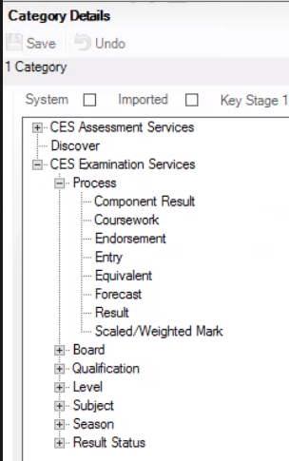
XML Results - Categories
Two new categories for Component Result and Scaled/Weighted Mark

Slide 36
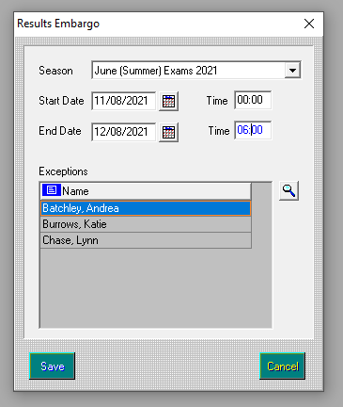
XML Results - Embargo
XML Results will be subject to the same Embargo rules as EO results via EDI R file
Focus | Examinations | Tools | School Setup | Results Embargo
List of areas impacted, where aspects are viewed:
Individual Reports / Profiles
Marksheets (EO - results not be available here)
Export Marksheets
ResultSet Analysis
Chance Analysis
Group Analysis
Trend Analysis
Report Dictionary

Slide 37
XML Results - Embargo
XML Results will only be placed into Aspects which can then be viewed in the usual ways as discussed in previous slides. However they will not be shown in the following areas at this stage:
Focus | Examinations | Tools | EDIT PI
Quick Links | Student | Exams
External Results
Reporting
Etc.

Slide 38
XML Results – Updated Results
As with existing results it is possible that a result is updated for example following a Pending decision (Q to a Grade)
Therefore results files with updated results may be issued
See following slides for information about how files are sequenced….

Slide 39
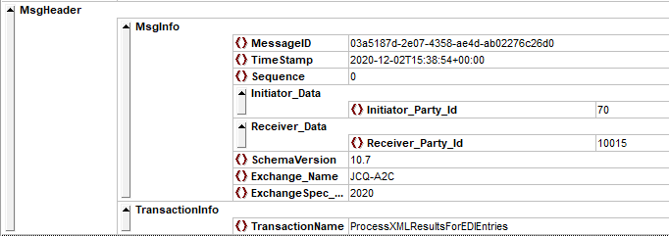
XML Results – File Date:Time Stamps
Sequencing of XML Results Files and Results
All results files have a unique “MessageID” (GUID) so we can check if they have been imported before
Files also have a date:time timestamp in the message header showing the time the file was created

Slide 40
XML Results – File Date:Time Stamps
Sequencing of XML Results Files and Results
Initial files will have a Message Header date:time timestamp of one second past midnight of the date of the restricted results download day for the results. So, if a results file is to be provided for the summer results in August it might be 2020-08-19T00:00:01+1:00
Any updated results files would be timestamped similarly with the date:time of the update
The result itself uses two dates.
QE_Outcome_Date : this will always be the publication date (not the restricted date)
QE_Outcome_Date_Time : this will be the time the file was created

Slide 41
XML Results – File Date:Time Stamps
Sequencing of XML Results Files and Results - Example
Attribute | 1st time results file | Updated results file
MsgHeader TimeStamp of Results FIle | Restricted Results DateTime 2020-08-19T00:00:01+01:00 | Update DateTime 2020-08-23T14:15:30+01:00
QE Outcome Date of Results | Result Release Date – Publication Date 2020-08-20 | Result Release Date – Publication Date 2020-08-20
QE Outcome Date Time of Results | Restricted Results DateTime 2020-08-19T00:00:01+01:00 | Update DateTime 2020-08-23T14:15:30+01:00

Slide 42
XML Results – File Date:Time Stamps
Sequencing of XML Results Files and Results - Example

Slide 43
XML Results – File Date:Time Stamps
The Outcome date of the file will always be the publishing date (not the restricted date) and will not be updated by updated results. This date can also be used to enforce the embargo.
The result itself uses two dates.
QE_Outcome_Date : this will always be the publication date (not the restricted date)
QE_Outcome_Date_Time : this will be the time the file was created

